Slide 1
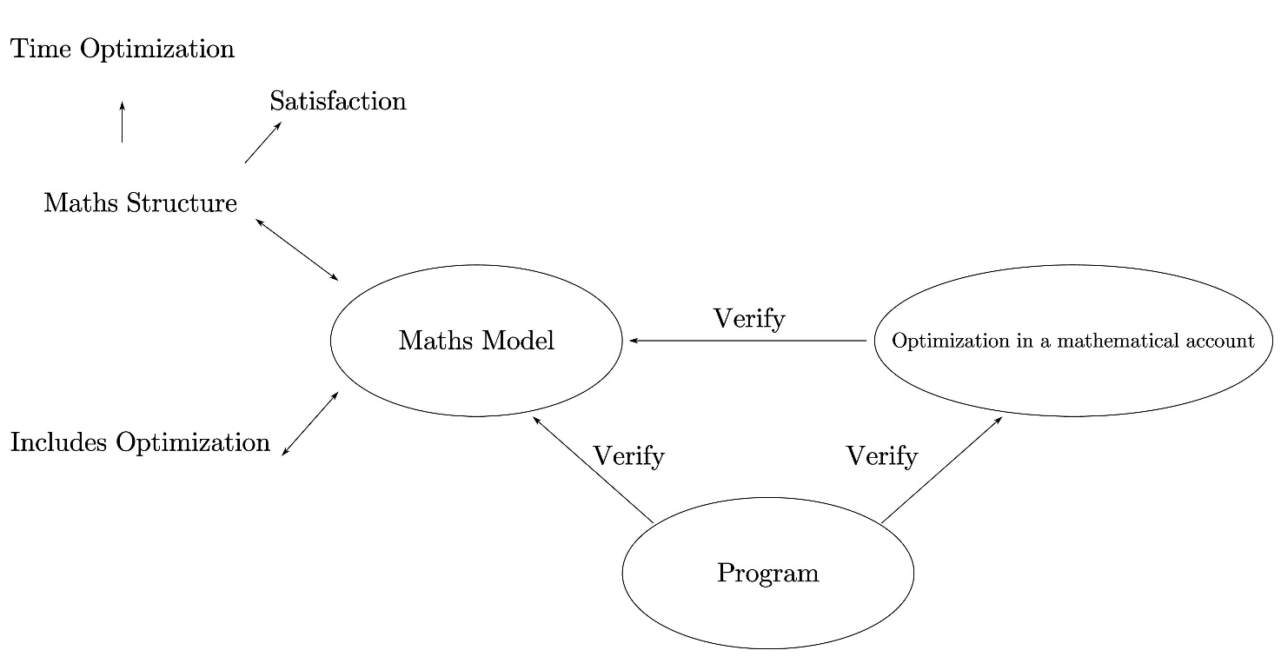
Model Analysis & Structure
What’s new?
Unlike conventional math modelling, mathematical analyses are included in our model.
This added part is mostly theoretical
What for?
It makes our logic more coherent, providing stout justifications for the intuitive notions & concepts raised in our model, as well as the results.
It significantly simplifies tedious calculations, especially during optimization.
It provides plausible strict mathematical explanations for our results.
Fig. The structure of our model

